Slide 1

Vanderbilt Mental Health Reform Working Group
Joseph Sexton
October 19, 2021

Slide 2
Icebreaker
What is an issue in mental health that you feel doesn’t get talked about enough?
  Also introduce your name, hometown, year, major, and pronouns if you don’t know the person you’re talking to!

Slide 3

Announcements
Mark your calendars: Vanderbilt Critical Psychiatry Conference (VCPC) on Saturday, January 22nd, 2022, 9AM – 3PM
  Panels of speakers filled with professors, nonprofit leaders, activists, and those with lived experience
Would you like to speak at our meeting next Tuesday? Contact Joseph for details

Slide 4
FOCUS ON REFORM:
REPLICATION CRISIS

Slide 5
FOCUS ON REFORM:
REPLICATION CRISIS
From Wikipedia: “an ongoing methodological crisis in which… many scientific studies are difficult or impossible to replicate or reproduce, severely affecting the social sciences and medicine… survey data strongly indicates that all of the natural sciences are probably implicated as well.”
Term came up in the early 2010s and has produced major moves in meta-science, most namely the push for Open Science

Slide 6
Why is the replication crisis concerning?
Medications and therapies that are supposed to work better than placebo oftentimes do not
  compare-trials.org
We base research on previous research
  Example: Professor A finds “evidence” that Method X can be used to generate Protein Z. Professor B uses Method X but cannot generate any of Protein Z. Professor B assumes they made a mistake since Professor A was peer-reviewed, and keeps investing money in Method X.

Slide 7


COMPare: Tracking Switched Outcomes in Clinical Trials
COMPare (Centre for Evidence-Based Medicine Outcome Monitoring Project) “systematically checked every trail [between October 2015 and January 2016] published in the top five medical journals, to see if they misreported their findings”
  New England Journal of Medicine (NEJM), Journal of the American Medical Association (JAMA), The Lancet, Annals of Internal Medicine, and the British Medical Journal (BMJ)

Slide 8
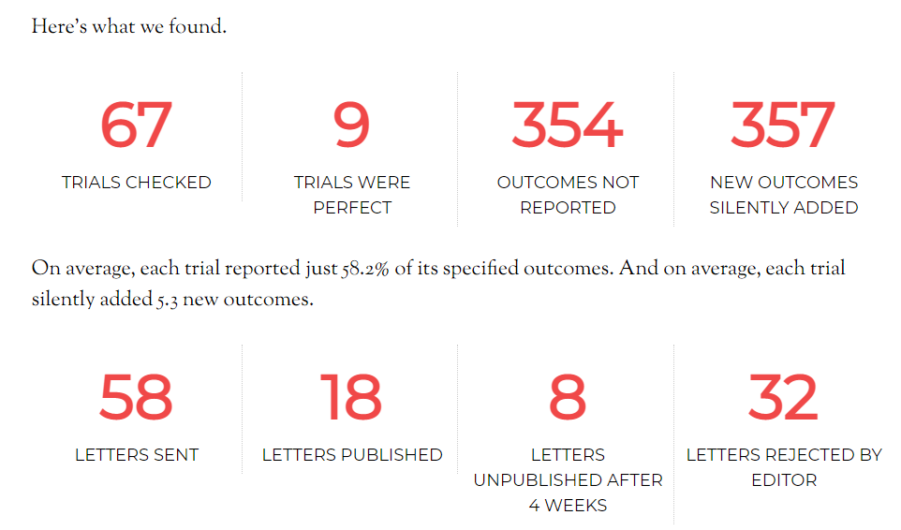
Notes:
Formal clinical trials are REQUIRED to be pre-registered by the United States National Library of Medicine (NLM). Yet, they are not required to be followed through with…! When people add or remove outcomes, it paints a drastically different – less clean – image of the intervention you are trying to promote with your study.

Slide 9
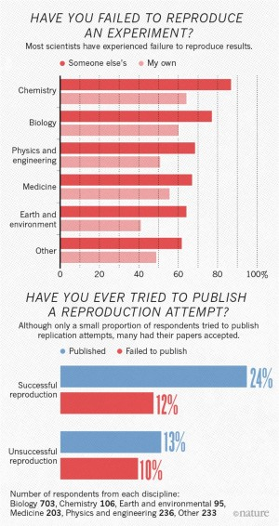
Furthermore…
Baker (2016)
Notes:
Published in Nature

Slide 10
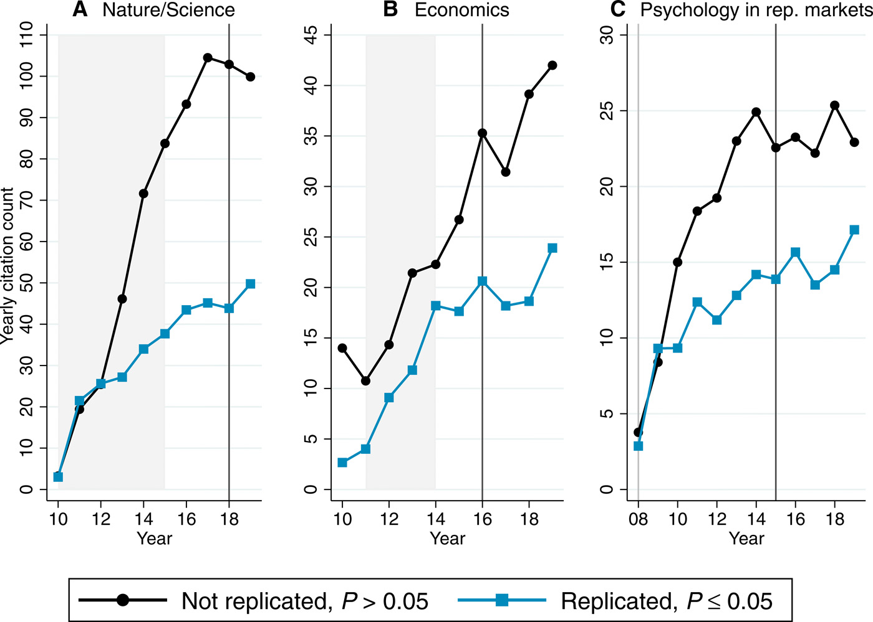
Furthermore
Serra-Garcia and Gneezy (2021)
Notes:
Published in Science… that’s citations on the y-axis, by the way!

Slide 11
How do we increase replicability in science?
Registered Reports: your paper is accepted before you collect your data
Preregistration: assuming you actually follow through (increase penalties for not doing so)
Open Data: making your datasets as public as possible so other people can try and replicate your statistical findings
Nonparametric and robust statistics, sensitivity analyses: for when you don’t meet the assumptions of the statistical test(s) that you are running, or want to see how slight variations in your data affect outcomes
Decoupling commercial interests: reduce conflicts of interest, third-party review

Slide 12
How does this relate to your mental health?
Studies in basic treatments like those of Prozac (fluoxetine), Zoloft (sertraline), and Thorazine (chlorpromazine) often fail to replicate or are repeated several times without statistical correction
  Who benefits from these studies?
Studies in psychosocial interventions have become increasingly concerning but for other reasons
  Even psychodynamic therapy is returning as statistically significant
  Who benefits from these studies?

Slide 13

QUESTIONS?

Slide 14
PROJECT UPDATES

Slide 15
Around the room
AROUND THE ROOM
What topic are you interested in, broadly?
WITH YOUR SPECIFIC GROUP
What resources have you found so far? What works and what doesn’t?
What are your ultimate goals? Present at the VCPC? Contact a legislator? Network with a local nonprofit?
BY NEXT TUESDAY
Have prepared a problem statement with a specific thesis or proposed solution
  E.g., “Firearm suicide is a major problem in the United States (source). It is especially pressing in Tennessee, where child firearm suicide rates are the third highest in the country. I propose child-access prevention (CAP) laws as one way to reduce child firearm suicide within our community.”

