Slide 1
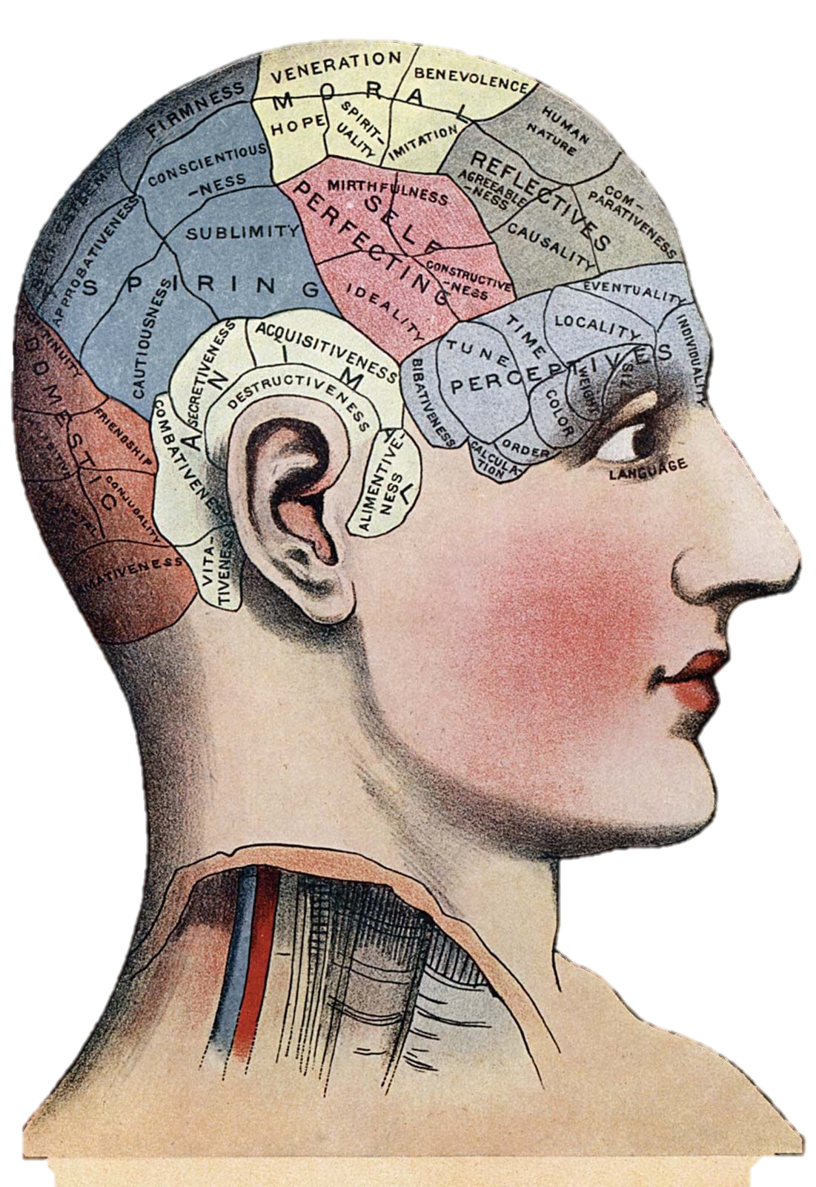

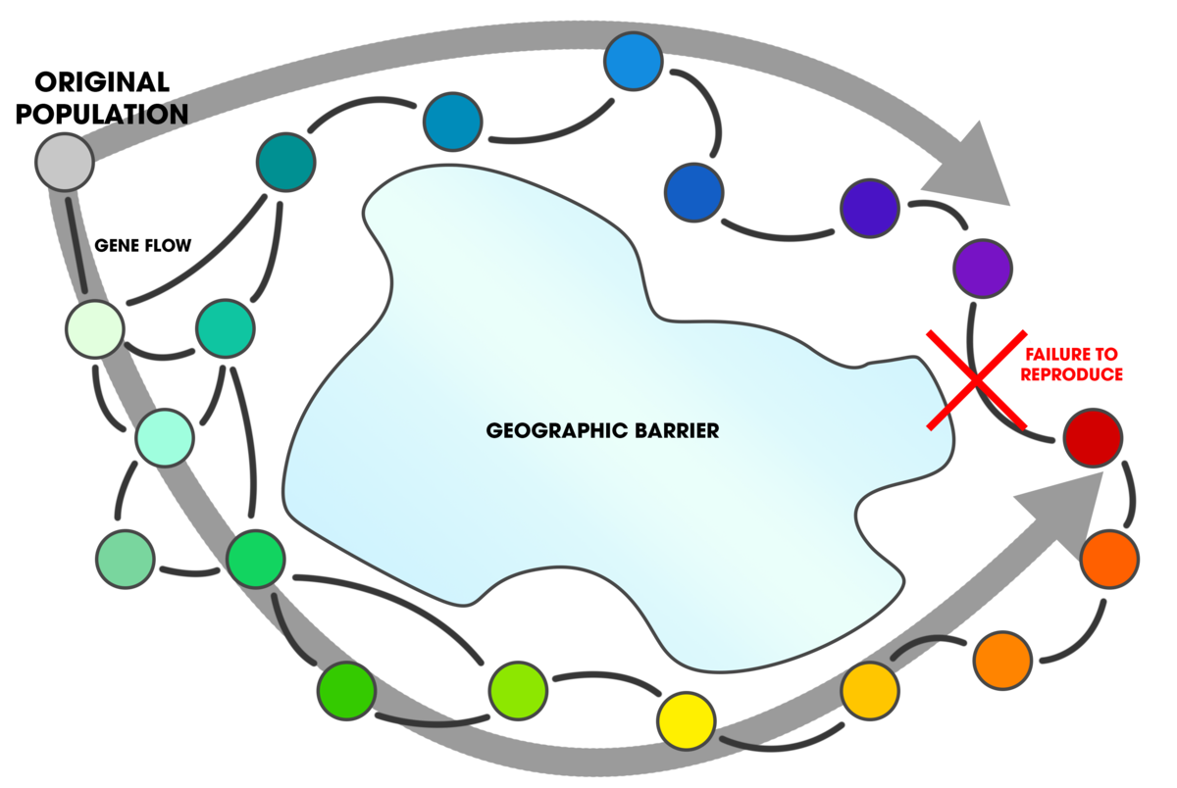

VANDERBILT
Mental Health Reform
2022-2023 MEETING #3
OCTOBER 19, 2022
Today’s Wikipedia page:
ring species.
Animals distributed around some geographic barrier can produce fertile young together (so they’re the same species), but this process isn’t transitive, meaning that just because bird A is the same species as bird B is the same as bird C does not mean birds A and C are the same species. Where does one species actually stop and the other starts? …wait, haven’t we heard this story before? (looks anxiously at DSM)

Slide 2
News
Joseph keeps mentioning that he is going to get people to help Mental Health America with some things
He is going to actually going to send that email tonight
The task at hand: Mental Health America of the MidSouth puts together educational events for therapists and clinicians around the state of Tennessee. The problem is finding (vetted) speakers. Sarah Weyhmuller is the Public Health Education Manager and needs help creating a spreadsheet of potential speakers stratified by different aspects of MHA’s mission (e.g., speakers in policy, clinical practice, ethics). You would get great experience and we can probably get this going for credit if you’d like a (super chill, virtual) internship in the Spring, or volunteering experience with a strong line on your CV/resume.
Please let me know if you want to get looped into this :)

Slide 3
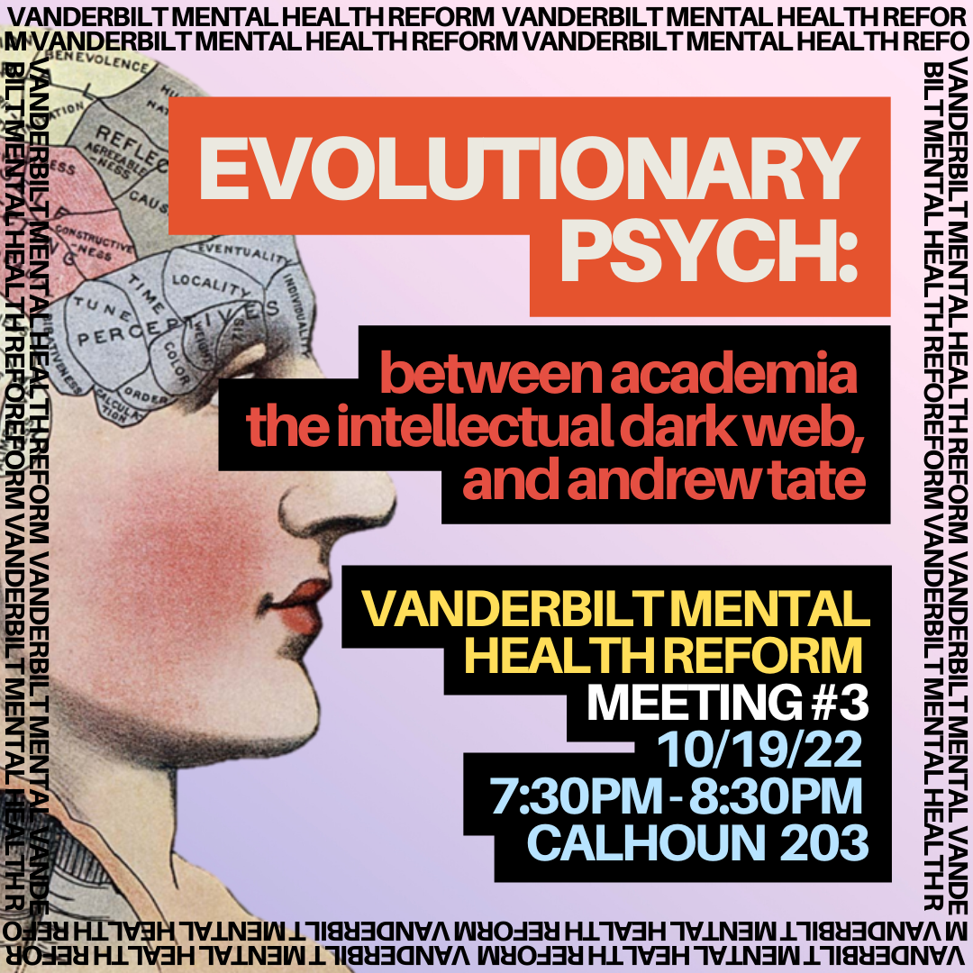

Slide 4
A history in evolutionary psychology
Training you to survive the modern world’s discussions:
1810 – 1840s: phrenology is born (Franz Gall)
1859: Darwin publishes On the Origin of Species
1865: Mendel’s pea experiments (genetics)
Early 1900s: rebirth of phrenology – “maybe we were right!”
1975: E.O. Wilson (“ant man”) publishes Sociobiology. His archnemeses Stephen Jay Gould and Richard Lewontin are down the hall (all three at Harvard’s biology department) and oppose Wilson to no end. They don’t speak in person but publish op-eds and send nasty emails about each other.

Slide 5
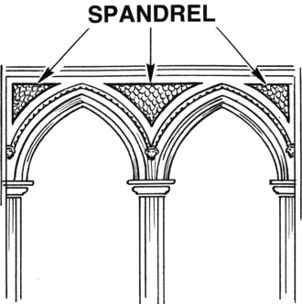
Must-know concepts
1979: Lewontin and Gould publish their seminal paper on the spandrels of San Marco and the premise of adaptationism
Spandrels of San Marco: spandrels are the triangular bits that come between arches, as observed at the Basilica di San Marco, Spain; what is their “purpose”? …well, they are just byproducts of the arch shape
adaptationism: the philosophy that all things are adaptations

Slide 6
Must-know concepts
Just-so hypotheses: no matter what you find, you can make it fit an evolutionary context
The problem with many evolutionary claims is that they are not truly knowable (in many cases)
  See caveats today like the Daphne Major finch!
You must specify things a priori (before data collection / unblinding) rather than post hoc (after data collection / unblinding) lest you hypothesize after results are known (HARK)

Slide 7
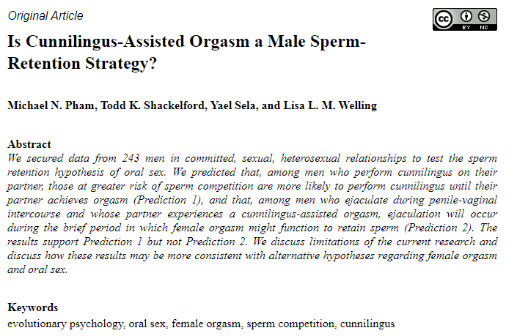

Slide 8
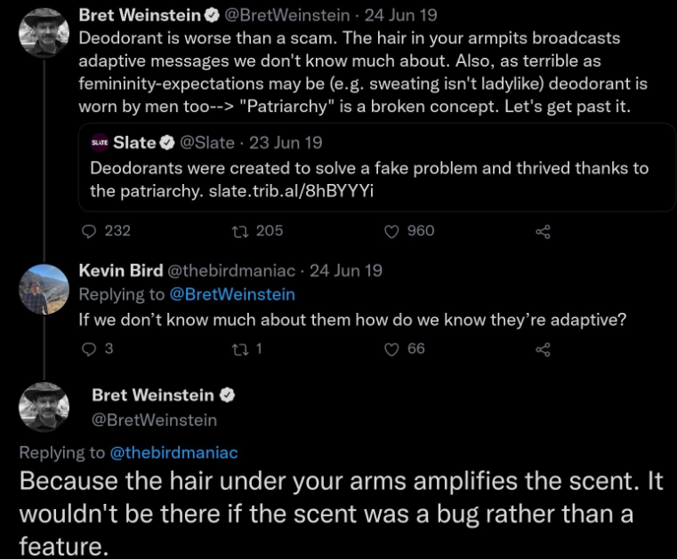
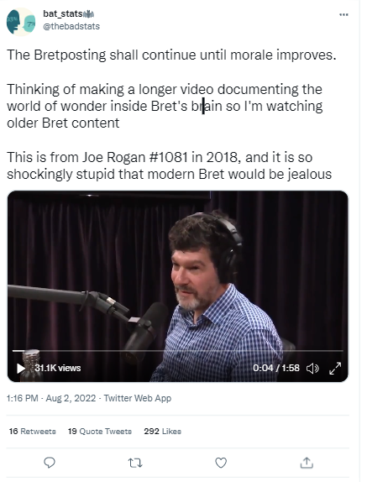
Examples? …and entering the Twitter drama

Slide 9
Enter the intellectual dark web (IDW)
Wikipedia: “a label which has been applied to some commentators who oppose what they regard as the dominance of identity politics, political correctness, and cancel culture in higher education and the news media within Western countries”
The term originated in 2017 when Bret Weinstein, evolutionary biologist, lost his position at Evergreen State College in Washington after criticizing (as loudly as humanly possible) an event that asked white students to stay off campus for one day (for complex and historical reasons that make some more sense in context, whether ultimately “right” or not)

Slide 10
Enter the intellectual dark web (IDW)
More broadly, we can think of public intellectuals who are resisting cancel culture and in the process are gaining notoriety
Jordan Peterson and Bret Weinstein are staples of Joe Rogan
The essential Twitter accounts:
  Let’s just look at them.
  @thebadstats
  @evo_psych_googling
On your own: enter evo psych/idw twitter (5 mins). What do you find? What’s interesting? How does this relate to existing systems of hierarchy/the influence of the intelligentsia?

