Slide 1


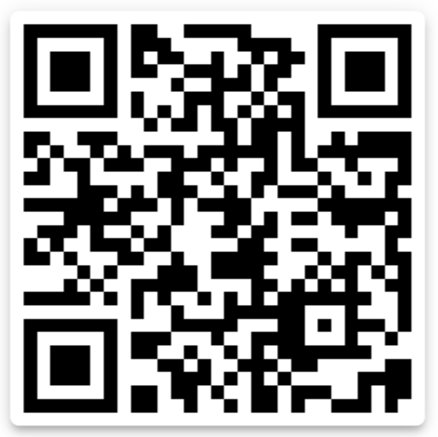

VANDERBILT
Mental Health Reform
2022-2023 MEETING #2
SEPTEMBER 28, 2022
Today’s Wikipedia page: ontological security

Slide 2
Welcome to Vanderbilt Mental Health Reform (MHR)!
Mission statement
Vanderbilt Mental Health Reform aims to supplement the (generally) one-dimensional (oftentimes) medicalized educations we usually get around mental health. We do this by introducing varied and critical perspectives of mental health care, drawing from philosophy, public policy, anthropology, history, neuroscience, statistics, history, psychology, and cultural studies, among others. We do this mainly through student- and guest-led talks, discussion, and volunteering.”
  Join our groupme <3

Slide 3


Slide 4
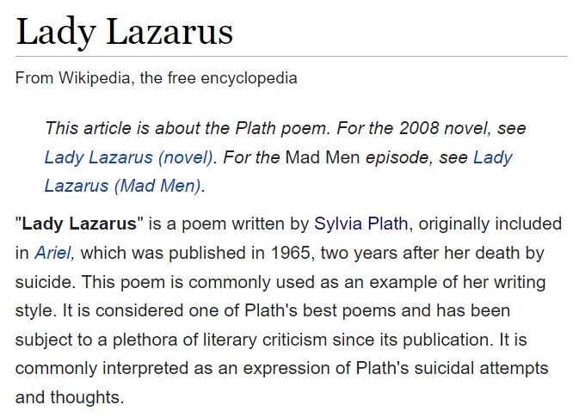



Slide 5
Overarching themes for today
What are the unique benefits of quantitative evidence?
What are the unique benefits of qualitative evidence?
…except, unlike in a basic methods class, think about these also in political contexts
  What is the political power of statistics?
  By the end be able to define epistemic violence

Slide 6
Defining quant vs. qual methods
Quantitative methods: using numerical methods (i.e., statistics) to predict outcomes or describe phenomena in a quantifiable manner
  Regression
  Inferential statistics (t-test, ANOVA, chi-squared)
  “Machine learning” (clustering, random forest, natural language processing, dimension reduction [factor analysis, principal components analysis])
Qualitative methods: evaluating data (stories, interviews, photos) by providing insights guided by your knowledge of theory and context
  Photovoice
  Ethnographic interview
  Autoethnography
  Thematic analysis

Slide 7
Defining quant vs. qual methods
Think about these in conversation with mental health, psychiatry, psychology, clinical science…
How have you heard these compared in class?
How would you compare them yourself?
Which would you trust? Do you trust them for different things?
Which gets more “credit” or funding in professional and academic institutions?
Is there a STEMocracy at Vanderbilt?

Slide 8
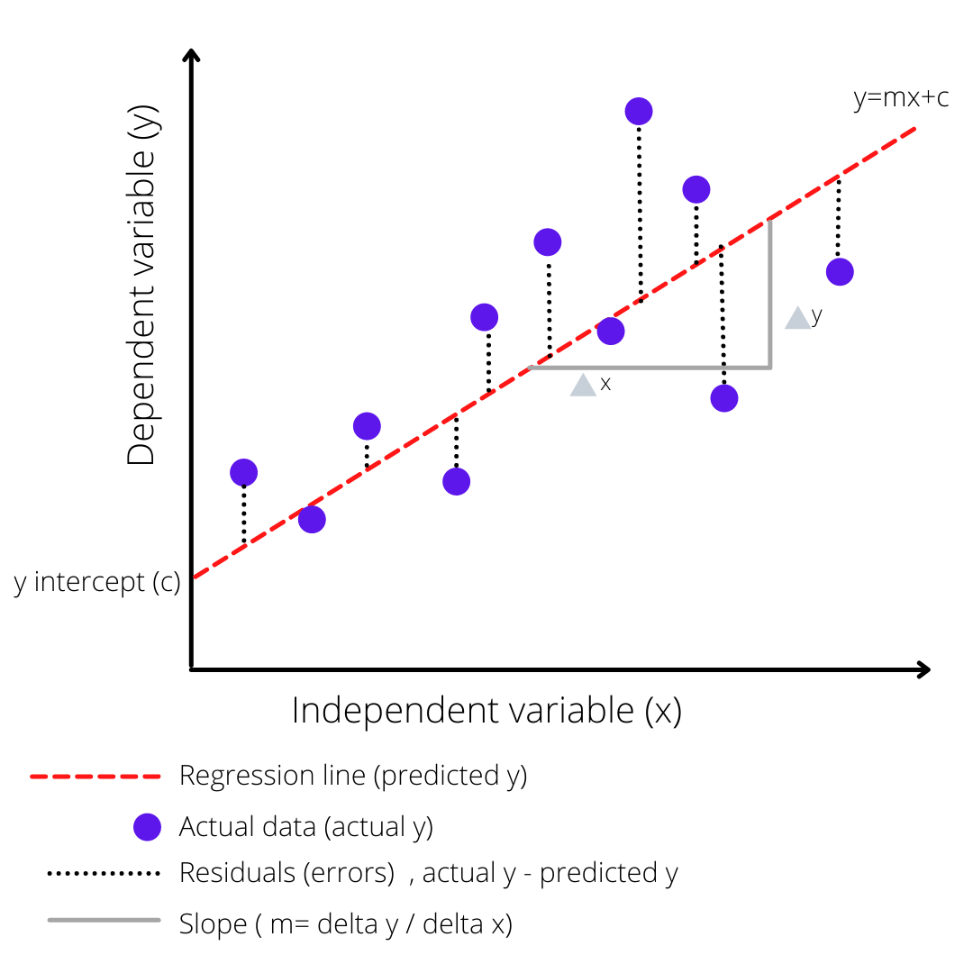
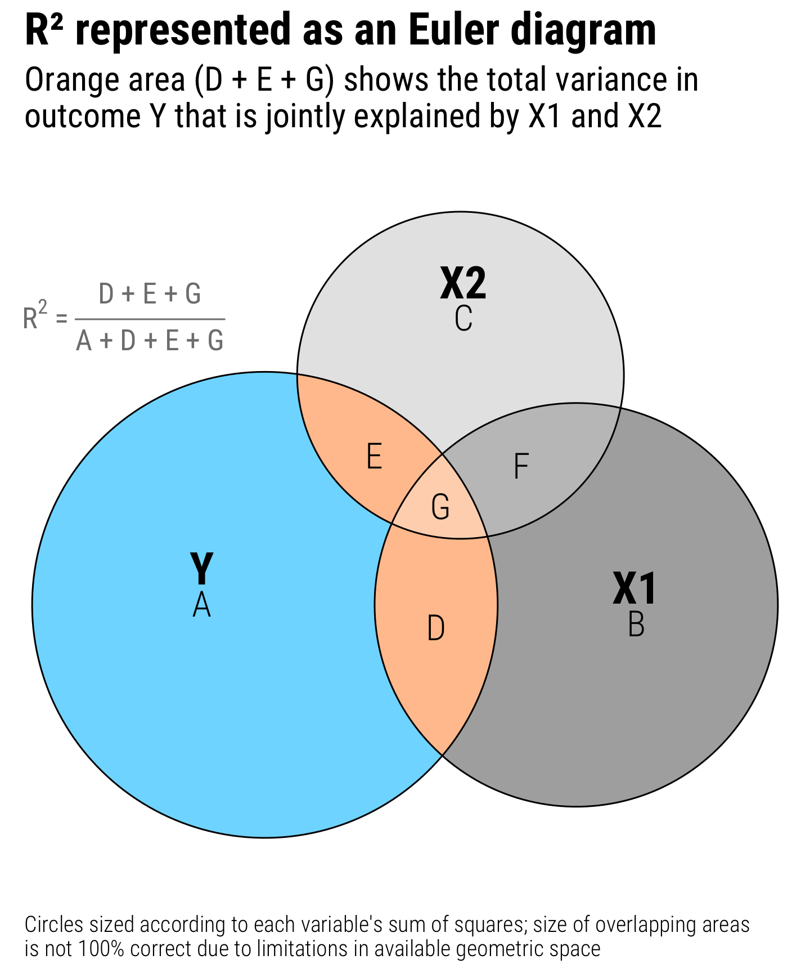
Quantitative Methods: Regression
Andrew Heiss (andrewheiss.com)
@sachin.hs20 on Medium

Slide 9
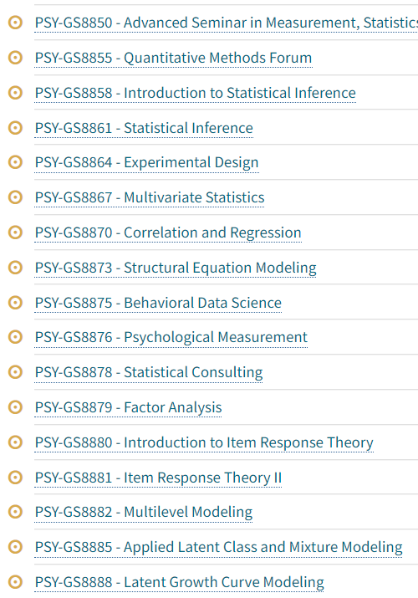


Slide 10
What would you record and enter into a model to predict suicide?
Keep in mind: you can measure categorical (discrete) as well as continuous variables
  We turn “categorical” variables like race, gender, and sexuality into numerical values by assigning people 0 or 1 values.
The more variables you enter, the better.
You can include interaction terms to capture “interactions” between variables.
  For example, say we think the effect of sexuality is different by race. Then we can say Queer = 0 (if straight), Queer = 1 (if queer); and BIPOC = 0 (if white), BIPOC = 1 (if nonwhite). Then the Queer*BIPOC “interaction term” will only apply to folks who are queer and BIPOC.

Slide 11
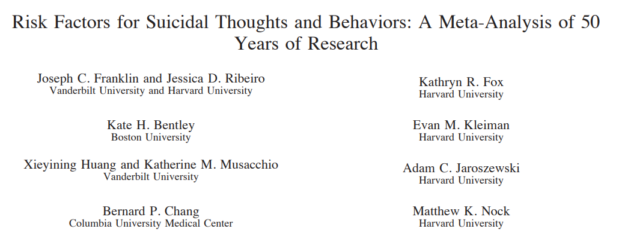
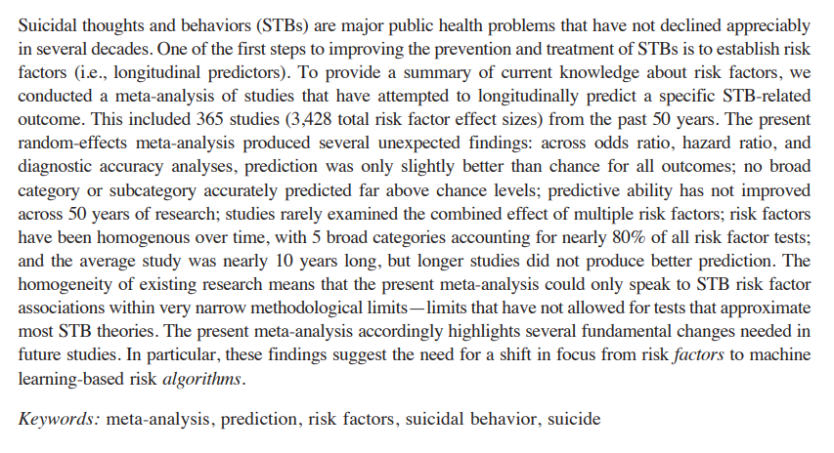

Slide 12
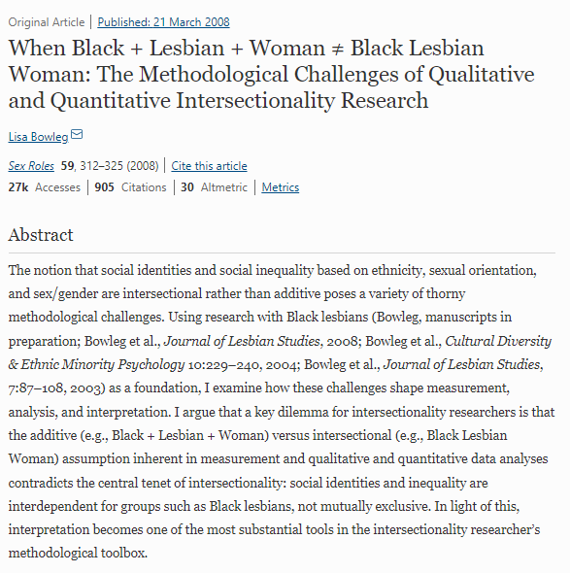
  S/o Dr. Kirsty Clark (MHS) for this recommendation

Slide 13
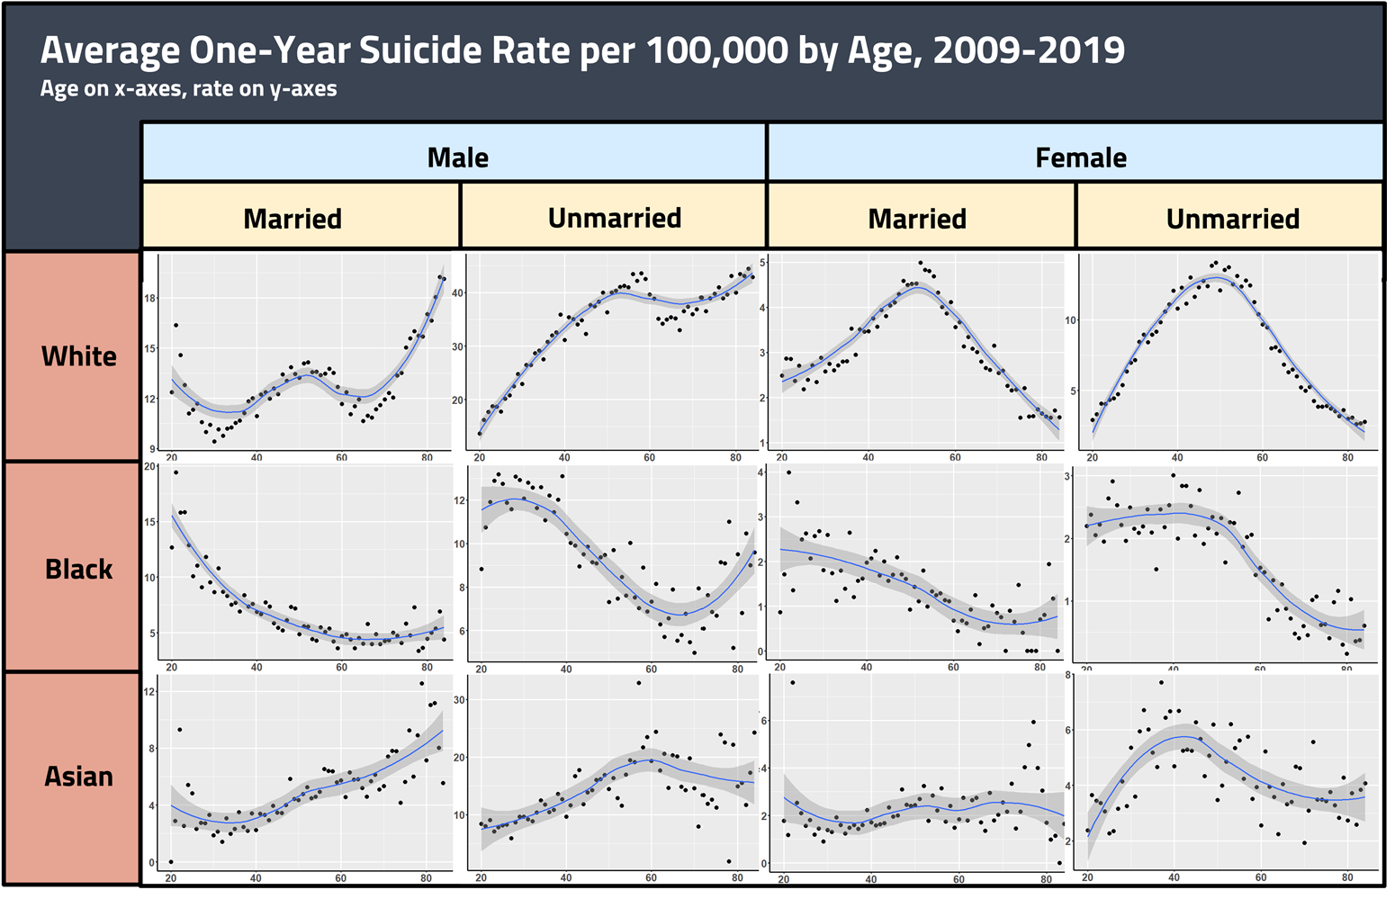
  Joseph made this using cdc data (N > 400,000) (N is research lingo for sample size/number of observations)

Slide 14

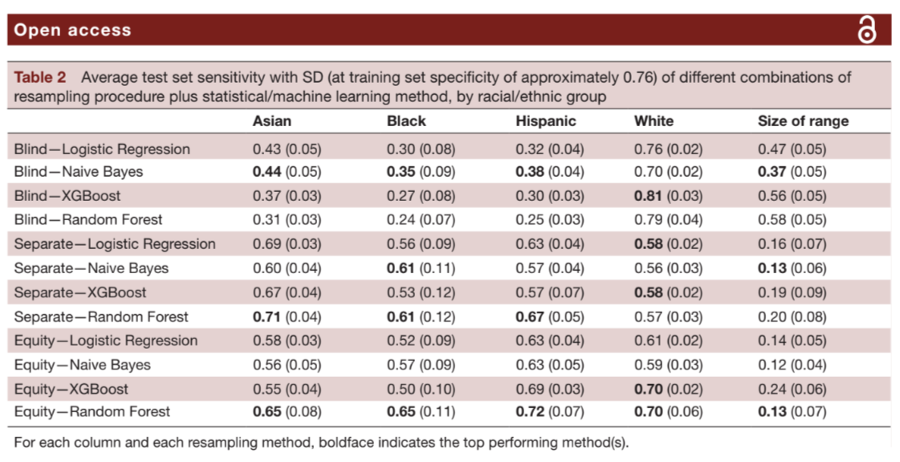

Slide 15
Defining quant vs. qual methods… politically
Think about these in conversation with mental health, psychiatry, psychology, clinical science. Discuss with a neighbor for a couple mins :)
How have you heard these compared in class?
How would you compare them yourself?
Which would you trust? Do you trust them for different things?
Which gets more “credit” or funding in professional and academic institutions?
Who loses when we take quant methods? (Whose suicides do we miss?)
Is there a STEMocracy at Vanderbilt?

Slide 16


Slide 17
Epistemic violence how discrimination and negative outcomes become embodied not just in our explicit actions, but in the way we

